Slide 1
What is an environment?
Rice Cultures 2019

Slide 2
How do we typically think of environment?
Natural environment
Good environment, bad environment
Protect the environment
National Environment Agency
Global environment
Global Environmental Change

Slide 3
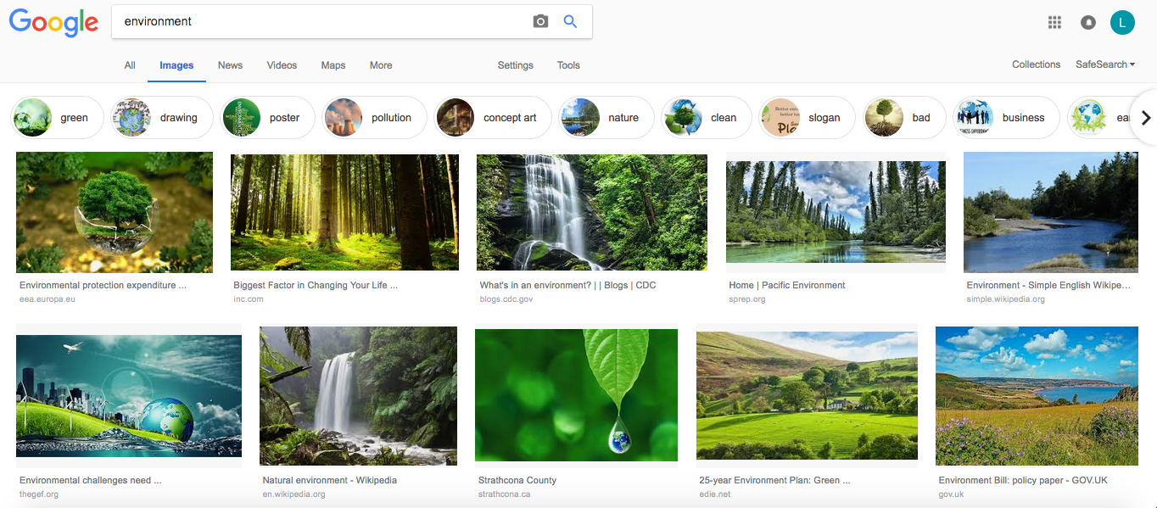

Slide 4
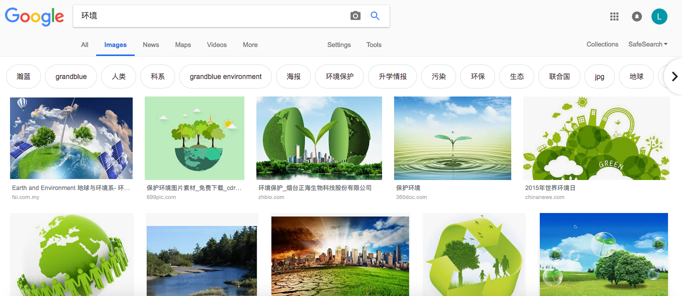

Slide 5

The Global Environment

Slide 6
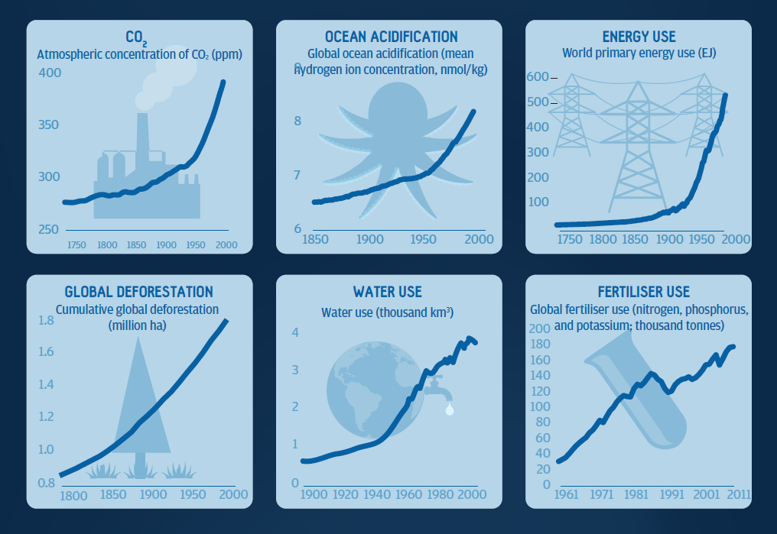
Source: Rockefeller Foundation and The Lancet

Slide 7
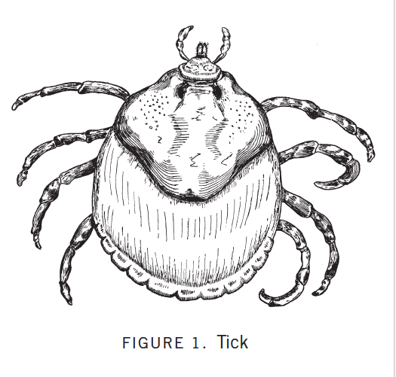

Slide 8
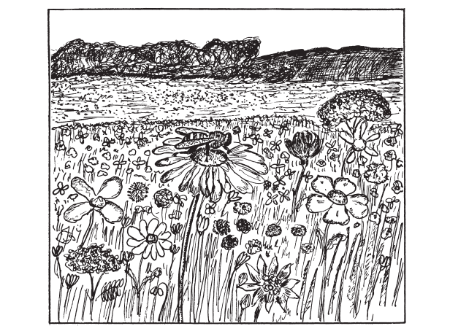
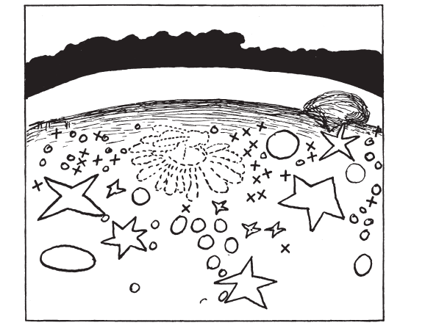
Honey bee
Surroundings (umbegung)
Environment (umwelt)

